Slide 1

Team 3 – Research and Initial Designs
Notes:
Liam:
Introduction to why group 3 (3rd group made, university project, 1 year)
Introduces ourselves to SecOps:
Liam – Project leader/manager, cyber security specialist
Toby – Ai specialist
Khyati – Cyber security specialist & Primary UI/UX Designer

Slide 2
Project Recap

Slide 3
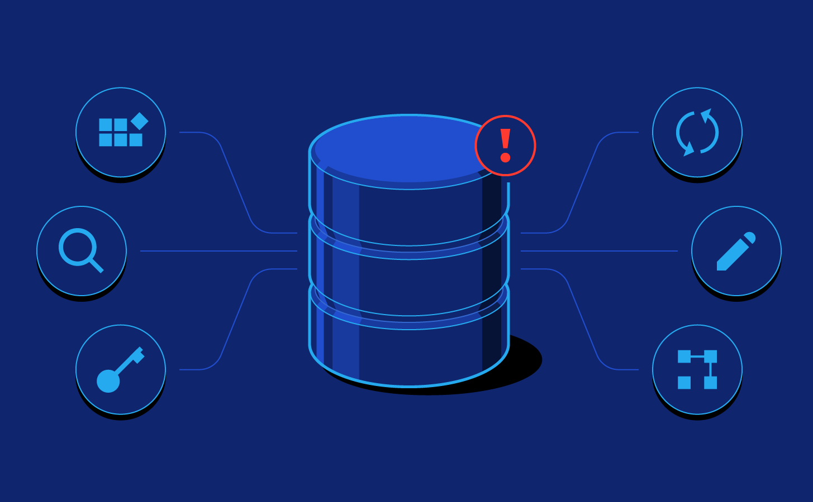

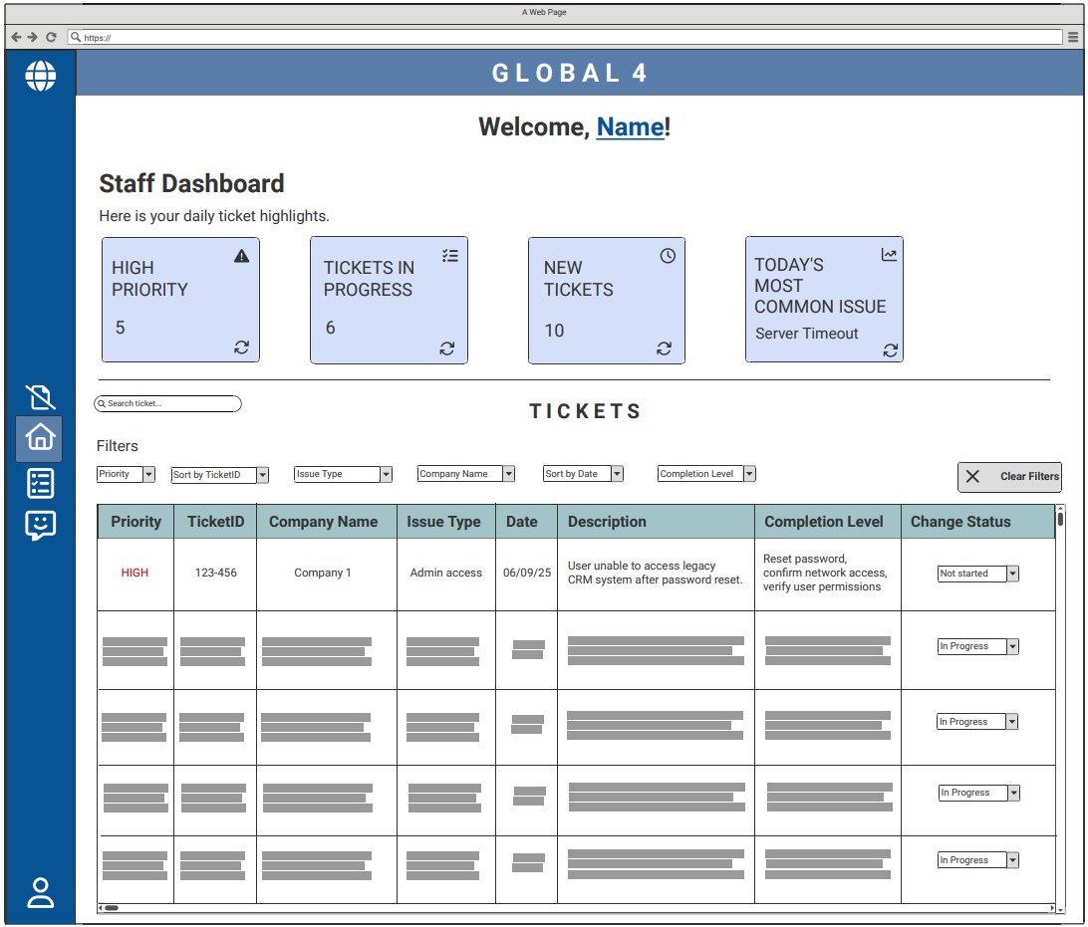
Stages of solution
Stage 1:
Ticket Creation
Stage 2:
AI data organisation
Stage 3:
Viewing Tickets
Notes:
Briefly explain project recap
1 sentence summary - "automatic ticket organisation for security Operations department "
Simplifying/organising automatic tickets raised to the Secops department.
AI organiser to separate tickets and assign them to a category
simplistic and familiar UI to hide all complex operations and database management.
Our primary goal is to provide a user-friendly interface & automating the manual process.

Slide 4
Stage 1 – Ticket Creation
Ticket Attributes
Company Name
Device
Issue type
Category of issue type
Contact Email
Contact Number
Date received
Status
Etc.
Stage 2:
AI data organisation… →
Use SQL to retrieve ticket data from database
Notes:
We use the relational databases and the issue alert to create a ticket inside the new software. This ticket will now look to be processed by the AI

Slide 5

Stage 2 - Ticket AI Organisation
[Company Name]:
Ticket1
Ticket2
Ticket3
Tickets:
Ticket1
Ticket2
Ticket3
Ticket4
Ticket5
AI reads and analyses data of each ticket
AI categorises and sorts tickets
Critical Alerts (Priority):
Ticket4
AI Ticket Organiser
Backups (Issue type):
Ticket5
Notes:
Ticket will be organised into different sections depending on priority/issue type/company/etc by an AI. This AI will be programmed to assist technicians by organising tickets in weighted system where the higher the weight of the ticket the more important the AI will consider the ticket. This means the AI will organise the categories and ticket queue as such.

Slide 6
Stage 3 - Viewing Tickets
Notes:
Khyati:
Explaining each UI design briefly. Try not to state the obvious as we are restricted by time in these meetings.
Short Example for a singular UI Screen "on the top half of this screen we have the organised sections (we will create categories upon feedback from SecOps) and below that we have a general space to mimick the aestethic of Autotask for alerts now if I click on this side button it will take us to …. [next scren]"

Slide 7
Ticket Viewing UX Design – Low Fidelity
Staff Dashboard
Tickets organised and displayed in a table
Can filter out specific tickets
Notes:
Initial designs and ideas. Can be modified and is not final. Home/ dashboard, shows highlights of the day at the top, all tickets in a table but with categories and filters.

Slide 8
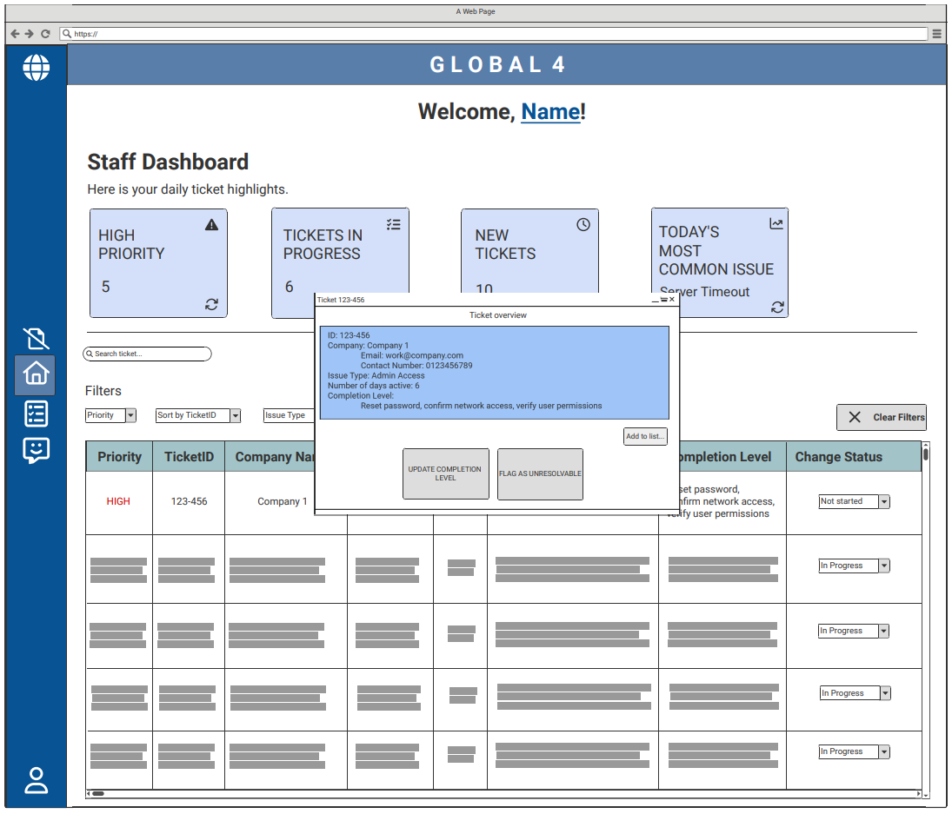
Ticket Pop-Up
Each ticket is clickable
Expands to show all options
Notes:
Can change completion level to log specific progress reached with a ticket. If the issue is too time-consuming or difficult, can mark it as unresolvable.

Slide 9
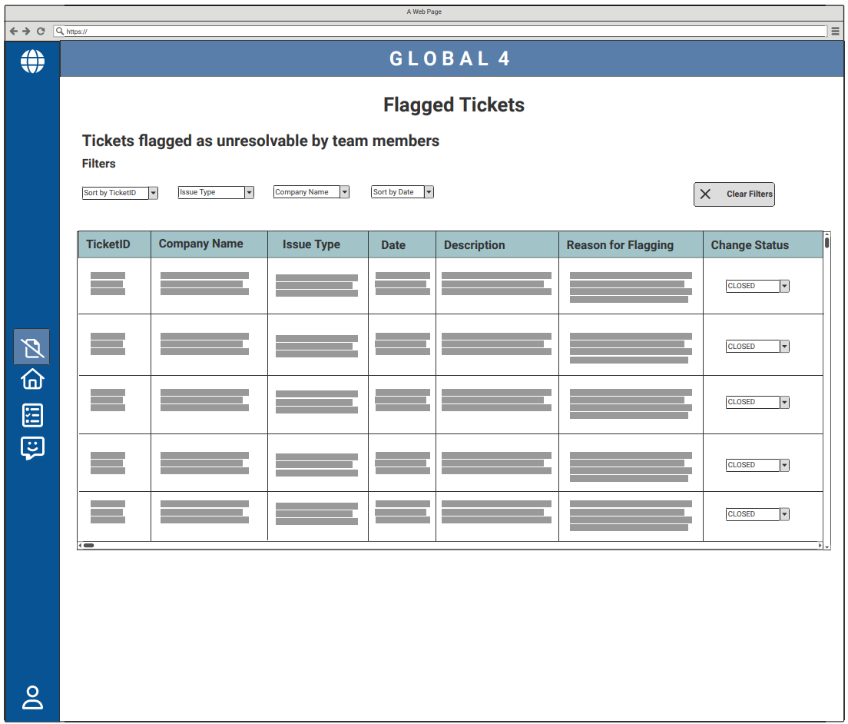
Flagged Tickets
Shows tickets flagged as unresolvable or closed tickets
Notes:
Tickets that were closed/inactive or flagged as unresolvable can be found here, in similar format as shown in dashboard.

Slide 10
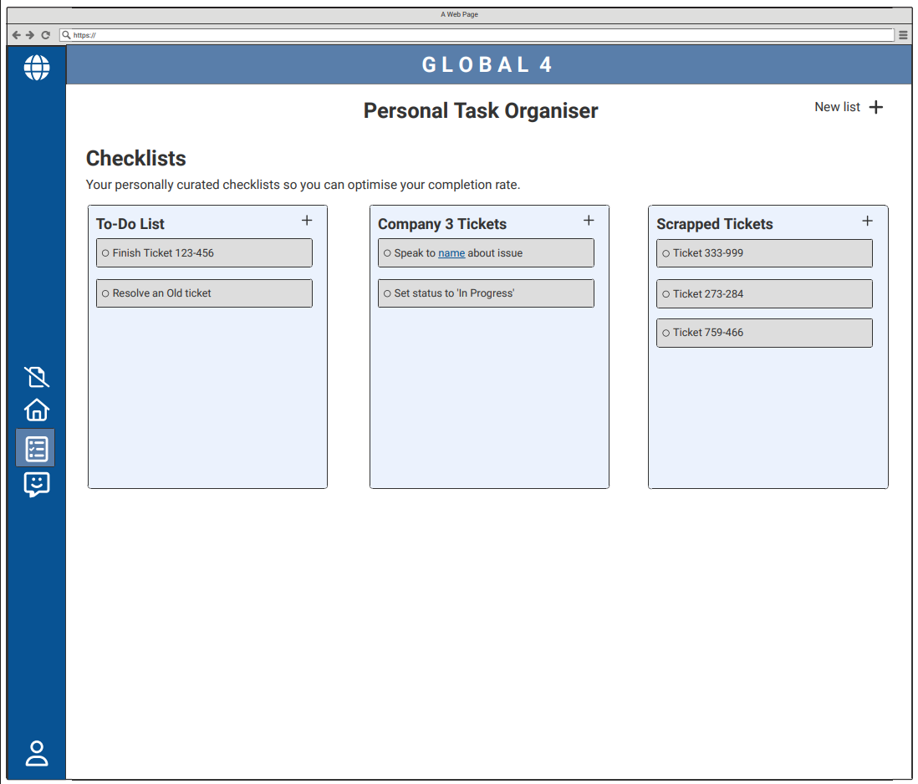
Non – functional requirement
Personal Task Organiser
Members can create checklists of assigned issues
Notes:
Useful feature that allows staff to manage their workload more efficiently and create lists, like in Trello.

Slide 11
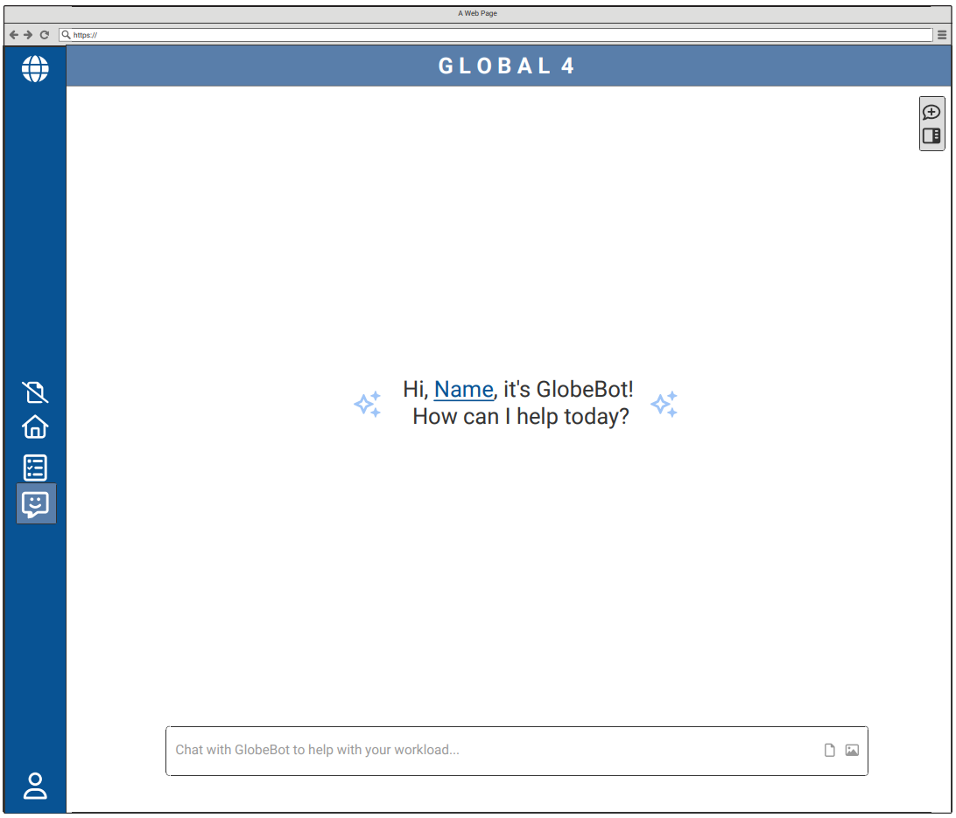
Non – functional requirement
Built-in AI chatbot
To help members organise workload
Notes:
Company’s own AI chatbot that staff can use if they struggle with volume of tickets, understanding how to prioritise.

Slide 12
Thank You

